Slide 1
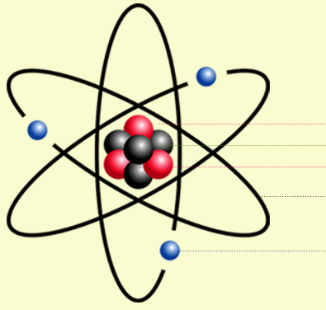
Daily Review
Describing the Structure of an Atom
State the number of protons and neutrons in the nucleus. State the number of electrons orbiting the nucleus. State whether the atom is neutral or charged. neutral = number of protons and electrons is equal charged = number of protons and electrons is not equal
Describe the structure of the beryllium atom.
Proton
There are ___ protons and ___ neutrons in the nucleus.
There are ___ electrons orbiting the nucleus.
The atom is ________ because __________.
Neutron
Electron

Slide 2
Daily Review
Reminder:
1st shell holds 2 electrons 2nd shell holds 8 electrons 3rd shell holds 18 electrons
Drawing Electron Shell Diagrams
Identify the number of electrons in the atom (hint: same as the number of protons) Draw a circle to represent the nucleus, including the symbol. Draw the first electron shell, and add electrons until it is full. Draw the second electron shell, and add electrons until it is full. Continue until all electrons are shown. Write the electron configuration underneath.
11 Electrons
Draw an electron shell diagram for sodium.
Na
Electron Configuration: 2, 8, 1

Slide 3
Daily Review
Reminder:
1st shell holds 2 electrons 2nd shell holds 8 electrons 3rd shell holds 18 electrons
Drawing Electron Shell Diagrams
Identify the number of electrons in the atom (hint: same as the number of protons) Draw a circle to represent the nucleus, including the symbol. Draw the first electron shell, and add electrons until it is full. Draw the second electron shell, and add electrons until it is full. Continue until all electrons are shown. Write the electron configuration underneath.
8 Electrons
Draw an electron shell diagram for oxygen.
O
Electron Configuration: 2, 6

Slide 4
Ions and Valency Year 9 Chemistry

Slide 5
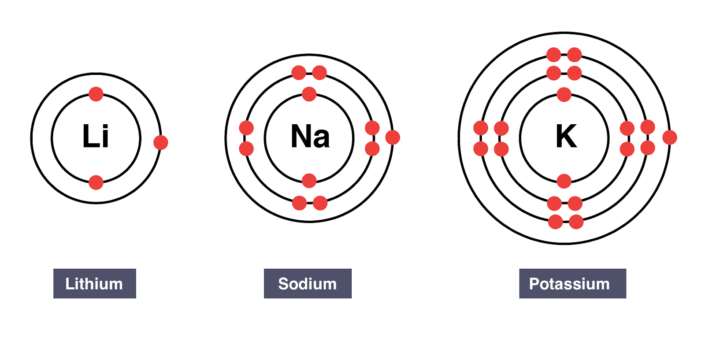
Learning Objectives
CFU
What are we going to learn?
Explain how ions form
Write symbols for common ions
Activate Prior Knowledge
Lithium, sodium and potassium are all group 1 elements.
Think, pair, share: what does the outer (valence) shell of the three atoms have in common?

Slide 6
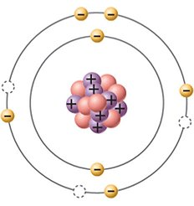
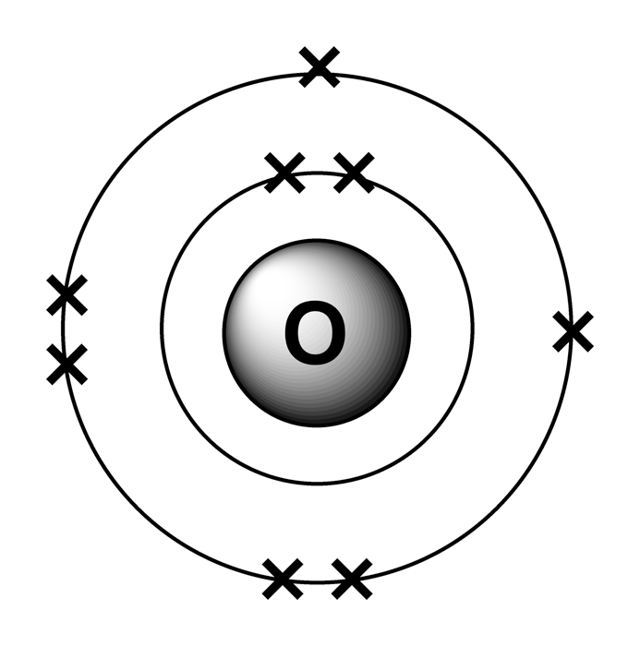
Concept Development
CFU 1
How are ions formed?
N³⁻
Ions
Ions form when atoms gain or lose electrons, becoming charged.
Atoms gain or lose electrons to obtain a full outer (valence) shell – the same as the nearest noble gas (group 18)
The nitrogen atom gains 3 electrons to fill the valence shell.
It gains three negative charges forming a nitride ion with a charge of 3-.
The charge of an ion is written at the top right of the symbol.
The charge on an ion is also called its valency.
CFU 2
Why does nitrogen have a negative charge, not a positive charge?
CFU 3
How many electrons would fill up the valence shell of the oxygen atom? What would its charge be?

Slide 7
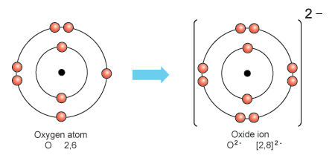
Concept Development
CFU 1
Do negative ions form when electrons are lost or gained?
Negative Ions
Formed when atoms gain electrons to fill the valence shell to the nearest noble gas configuration.
The number of electrons the atom gains becomes the negative charge on the ion.
Oxide ions form when an oxygen atom gains 2 electrons.
Fluoride ions form when a fluorine atom gains 1 electron.
CFU 2
Chlorine is in the same group as fluorine. How many electrons would it gain?
CFU 3
Write the symbol for a chloride ion.
O²⁻
F⁻

Slide 8
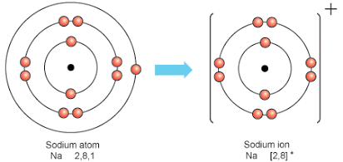
Concept Development
CFU 1
Do positive ions form when electrons are lost or gained?
Positive Ions
Formed when atoms lose electrons to empty the valence shell to the nearest noble gas configuration.
The number of electrons the atom loses becomes the positive charge on the ion.
Sodium ions form when a sodium atom loses 1 electron.
Calcium ions form when a calcium atom loses 2 electrons.
CFU 2
Barium is in the same group as calcium. How many electrons would it lose?
CFU 3
Write the symbol for a barium ion.
Na⁺
Ca²⁺

Slide 9
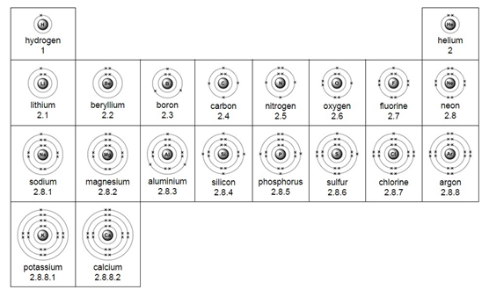
Concept Development
CFU 1
Strontium is in group 2. What is the valency of a strontium ion?
Using the Periodic Table to Predict Valencies
Elements in group 1 always lose their valence electron, forming ions with a valency of 1+ H⁺ Li⁺ Na⁺ K⁺
Elements in group 2 always lose 2 valence electrons, forming ions with a valency of 2+ Be²⁺ Mg²⁺ Ca²⁺
Group 1
CFU 2
Rubidium is underneath potassium on the Periodic Table. What is its valency?
Group 2

Slide 10
Concept Development
CFU 1
Iodine is in group 17. What is the valency of an iodide ion?
Using the Periodic Table to Predict Valencies
Elements in group 17 always gain one valence electron to fill the valence shell, forming ions with a valency of -1 F⁻ Cℓ⁻ Br⁻
Elements in group 16 always gain 2 valence electrons to fill the valence shell, forming ions with a valency of -2 O²⁻ S²⁻ Se²⁻
CFU 2
Group 15 elements have 5 valence electrons. How many electrons would an atom in this group gain?
Group 18
Group 16
Group 17
CFU 3
Nitrogen is in group 15. what is the valency of a nitride ion?

Slide 11
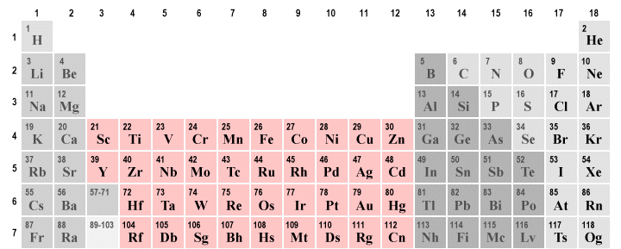
Concept Development
CFU 1
Copper can have a valency of +1 or +2. Write the symbol for the two ions.
Elements with Multiple Valencies
Some transition metals can form ions with different valencies.
Lead can form ions with a valency of 2+ or 4+ Pb²⁺ or Pb⁴⁺
The valency is written as roman numerals in brackets after the name of the element Lead (II) or Lead (IV)
CFU 2
Copper can have a valency of +1 or +2. Write the name for the two ions.

Slide 12
Skill Development/Guided Practice
Writing Ions
Draw an electron shell diagram of the atom. Identify the number of valence electrons. Identify the number of electrons that will be lost (becoming positive ion) or gained (becoming negative ion) Write the symbol and valency of the ion
What is the valency of a lithium ion?
1 valence electron
1 electron is lost, becoming positive ion
Li
Li⁺

Slide 13
Skill Development/Guided Practice
Writing Ions
Draw an electron shell diagram of the atom. Identify the number of valence electrons. Identify the number of electrons that will be lost (becoming positive ion) or gained (becoming negative ion) Write the symbol and valency of the ion
What is the valency of a chloride ion?
7 valence electrons
1 electron is gained, becoming a negative ion
Cℓ
Cℓ⁻

Slide 14
Skill Development/Guided Practice
Writing Ions
Draw an electron shell diagram of the atom. Identify the number of valence electrons. Identify the number of electrons that will be lost (becoming positive ion) or gained (becoming negative ion) Write the symbol and valency of the ion
What is the valency of an aluminium ion?
3 valence electrons
3 electrons are lost, becoming a positive ion
Aℓ
Aℓ³⁺

Slide 15
Skill Development/Guided Practice
Writing Ions
Draw an electron shell diagram of the atom. Identify the number of valence electrons. Identify the number of electrons that will be lost (becoming positive ion) or gained (becoming negative ion) Write the symbol and valency of the ion
What is the valency of an magnesium ion?
2 valence electrons
2 electrons are lost, becoming a positive ion
Mg
Mg²⁺

Slide 16
Skill Development/Guided Practice
Writing Ions
Draw an electron shell diagram of the atom. Identify the number of valence electrons. Identify the number of electrons that will be lost (becoming positive ion) or gained (becoming negative ion) Write the symbol and valency of the ion
What is the valency of a sulfide ion?
6 valence electrons
2 electrons are gained, becoming a negative ion
S
S²⁻

Slide 17
Skill Development/Guided Practice
Writing Ions
Draw an electron shell diagram of the atom. Identify the number of valence electrons. Identify the number of electrons that will be lost (becoming positive ion) or gained (becoming negative ion) Write the symbol and valency of the ion
What is the valency of a phosphide ion?
5 valence electrons
3 electrons are gained, becoming a negative ion
P
P³⁻

Slide 18
Relevance
Knowing how electrons are arranged in an atom will help you understand how different atoms react together in predictable ways to form compounds.

Slide 19
Skill Closure
How are ions formed?
Skill Closure
Will the oxygen atom gain or lose electrons? Explain your choice.
Skill Closure
Writing Ions
Draw an electron shell diagram of the atom. Identify the number of valence electrons. Identify the number of electrons that will be lost (becoming positive ion) or gained (becoming negative ion) Write the symbol and valency of the ion
Write the symbol and valency of an oxide ion.

Slide 20
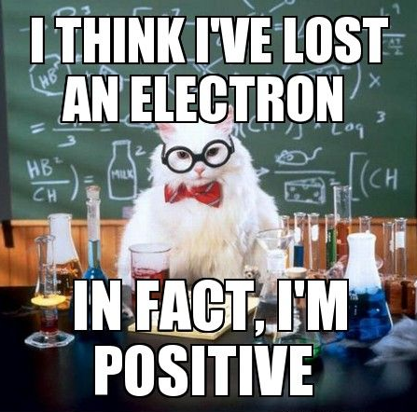
Independent Practice
Complete the “Ions and Valency” worksheet on your device or on a paper copy.

